Slide 1
SRC PROJECT
INVENTORY MANAGER
Karlos De Los Santos, Hoang Quan Dinh, Aryan Mitharwal, Alicia Prince, Hadya Rohin

Slide 2

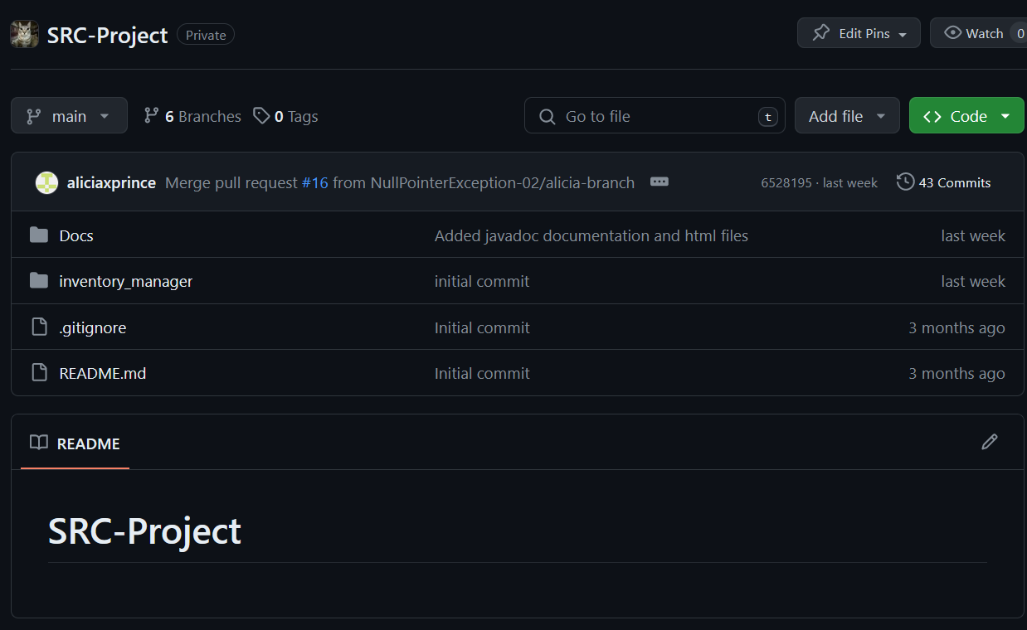
Team NullPointerException

Slide 3
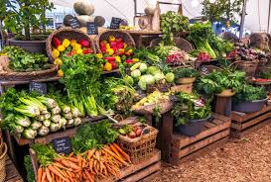
The issue?
There was a struggle with produce tracking/inventory
Currently use paper
Difficult to track how much donated and produced each season

Slide 4

Our Solution
An automated inventory system for tracking how much produce is donated and grown
Creates a more organized system
Furthers efficiency
Minimizes human error
Maintains a strong foundation
for farm

Slide 5

Main Features
Program allow the employees to enter produce, quantity, and weight
Produce quantity can be altered
A search bar implemented
Displays data when searching

Slide 6
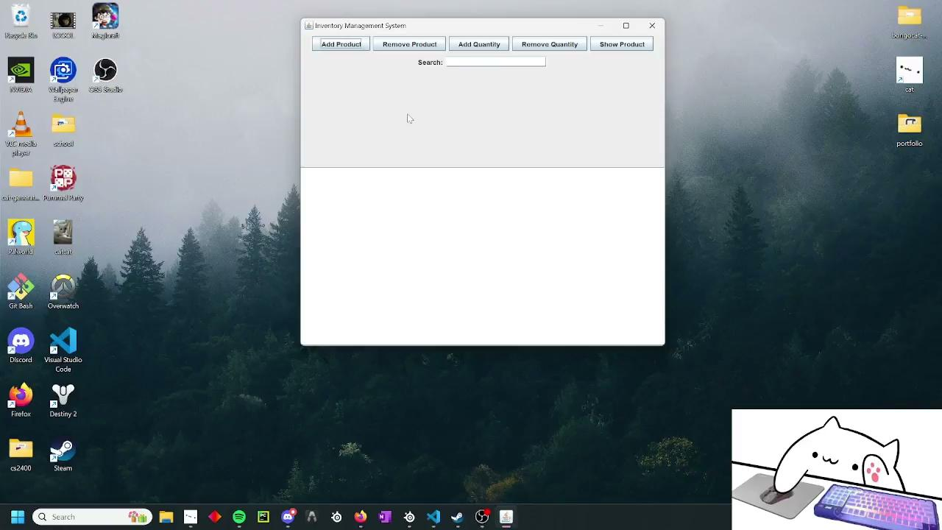
Code Demo

Slide 7



Classes
Main
Class
Produce
Class
Inventory
Class

Slide 8
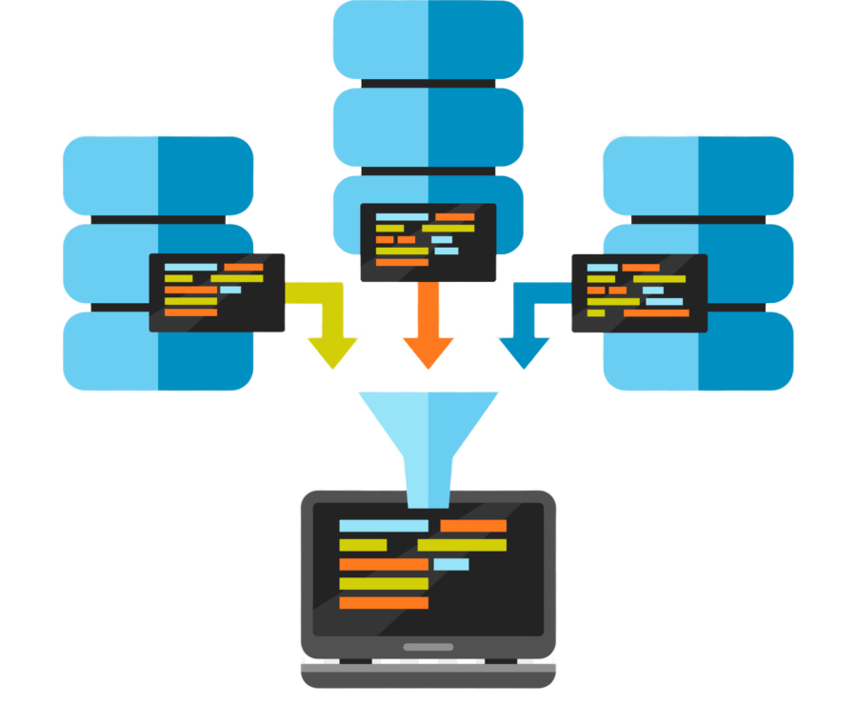
Main Class
Heart of our inventory system
Acts as an entryway/control hub
Contains various interface components
Saves and loads data files

Slide 9
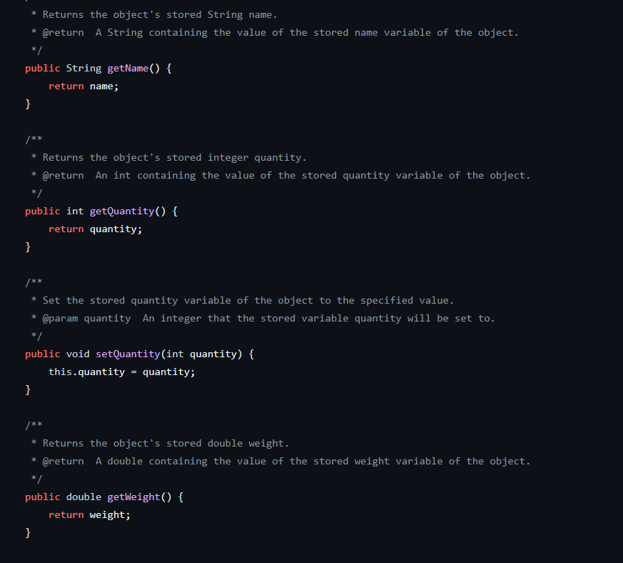

Produce Class
Mainly consists of setters and getters
Holds details like name, weight, and quantity

Slide 10
Inventory Class
addProduct
searchForProduct
showProduceData
addToExisitingEntry
removeQuantity
saveInventory
Most methods in our program contained here
Adds product into current list w/ unique ID
Searches any product and its data in inventory
Shows name, weight, & quantity of product
Adds a quantity to an existing produce entry
Removes a quantity from a produce entry
Saves all current data in the inventory

Slide 11
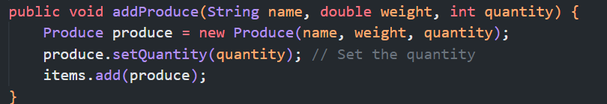

addProduce
Adds in a new product into ArrayList with name, weight, and quantity as object fields
A string containing the name
A double including the weight
A integer for the quantity of one produce

Slide 12
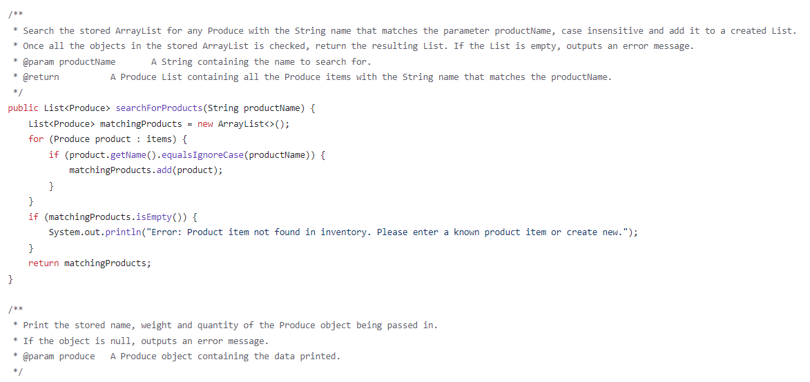

searchForProducts
Searches the ArrayList for product that matches name
If match found, add to List and eventually return List
If not found, an error message prints

Slide 13
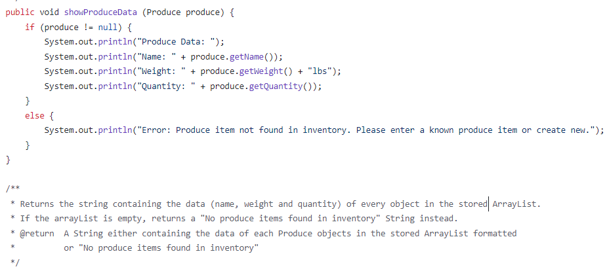

showProduceData
Returns a string containing various data
If produce not found, out prints an error

Slide 14
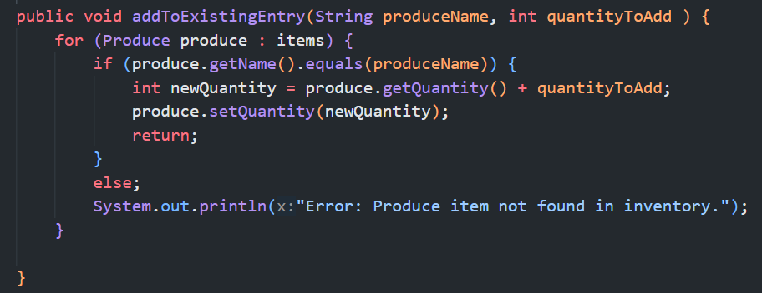
addToExistingEntry
Adds a certain quantity to an existing produce in the ArrayList
No matching produce = error message.
A string that indicates the produce name to add the quantity to
An integer with the amount of quantities desired to add

Slide 15
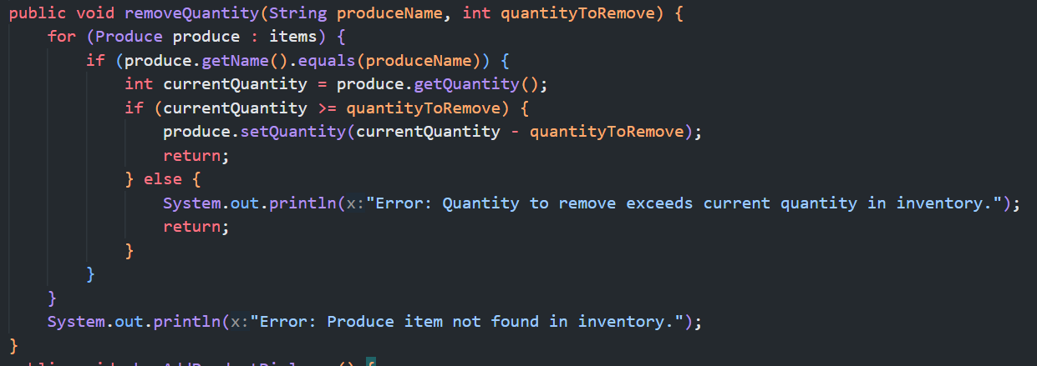
removeQuantity
Remove a certain quantity from a product in the ArrayList
String indicates which produce
Integer is amount to remove
Error message if quantity removed exceeds quantity stored
Produce does not exist = error code and exiting method

Slide 16
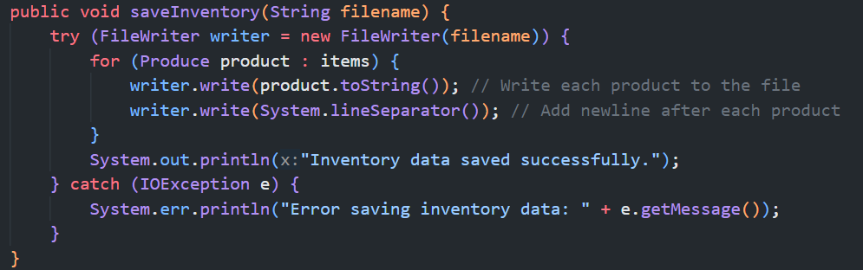
saveInventory
Saves the inventory data to a file
File name is automatically named “inventory.txt” upon shutdown with shutdown hook

Slide 17
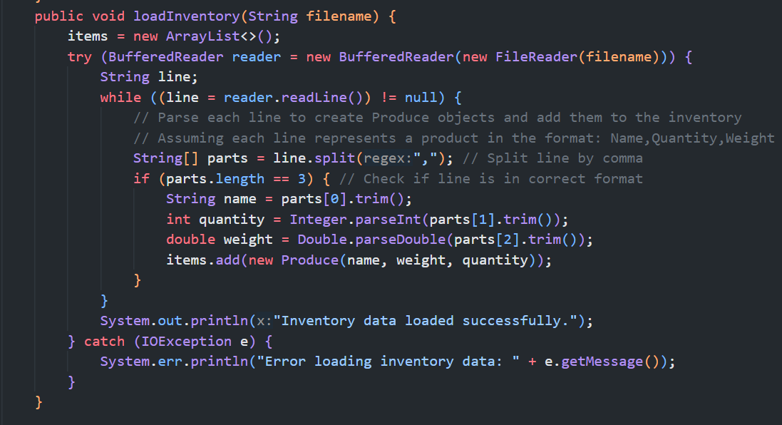
loadInventory
Loads inventory data from file into CSV format
String filename is the name of file with inventory data

Slide 18
GUI

Slide 19
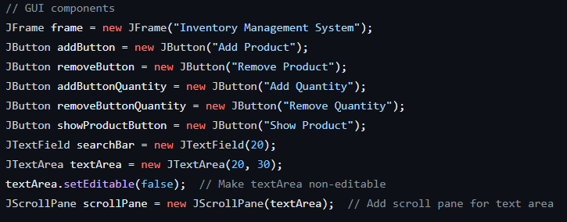
Five Main Buttons:
Add Product
Remove Product
Add Quantity
Remove Quantity
Show Product

Slide 20
The ‘searchBar’ field allows users to find specific products. The ‘textArea’ displays product information and is non-editable. Lastly, we've added a ‘JScrollPane’ to ensure smooth navigation through product data. These components ensure a user-friendly experience, making inventory management efficient.

Slide 21
Conclusion
Thank you for listening

